Slide 1
History of Air Rifle
Target rifle shooting involves firing in three different shooting positions: prone, standing, and kneeling. These shooting positions originated with firing positions that once were taught to warriors and soldiers and were used in battle or hunting. Today, these firing positions have turned into specific shooting and are defined by competition rules recognized throughout the world.

Slide 2
Team Requirement
Every cadet must receive a grade of 100% on the safety test to qualify and be part of the Air Rifle team.

Slide 3
What is the Air Rifle team?
Air rifle is a team that teaches cadets how to:
Aim a rifle correctly
Handle and shoot a rifle in three different positions
Sharp shoot
Knowledge of safety and rules when handling an air rifle

Slide 4
Positions of Shooting
Each cadet will learn to shoot in these three positions: prone, standing, and kneeling.

Slide 5
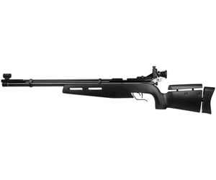
Crosman Challenger .177 mil Air Rifle
It is a high pressure, bolt action, single shot air rifle
It uses pellets
It weighs 7.1 lbs.

Slide 6
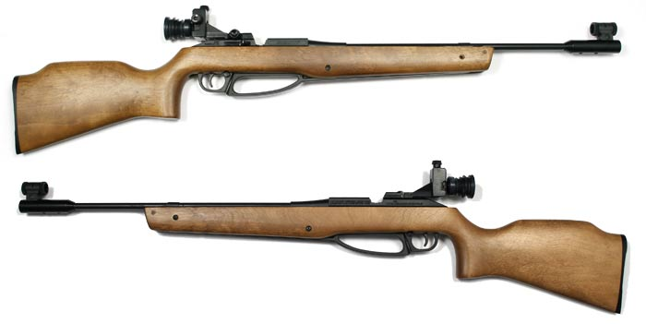
Daisy .177 mil Air Rifle
It is a high pressure, lever action, single shot air rifle
It uses pellets
It weighs 2.2 lbs.

Slide 7
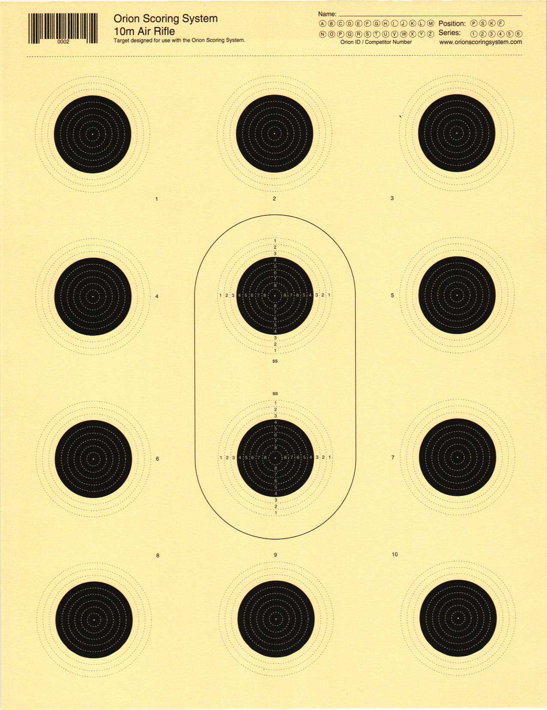
Orion 12 Bull Air Rifle Targets
Targets used in practice and competitions.
The two middle targets are used for sighting in and making practice shots
Shoot at these two as many times as you need but do not shoot outside of the black ring.
The ten targets that are surrounding the middle two are used for scoring.
Only one shot per one target.

Slide 8
Fun
Throughout the year we will have our own competitions to compete for prizes.
You will gain friends and memories.
Cadets receive a ribbon for competing in competition.
This is the ribbon cadets receive for air rifle.

